Slide 1
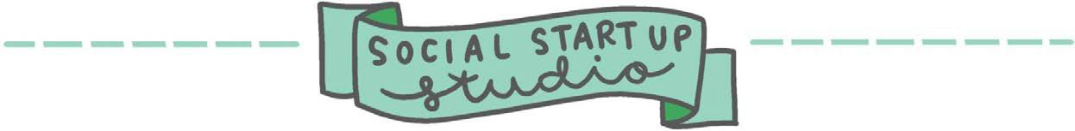

Workbook
SOCIAL
ENTERPRISE FUNDAMENTALS
Exercises and tools to build sustainable and impactful social enterprises
© Swinburne University of Technology
2020

Slide 2

socialstartupstudio.com.au
About this Workbook
Welcome to the Social Enterprise Fundamentals Workbook. This book is a resource for people and organisations thinking about starting a social enterprise. It forms part of the Swinburne Social Startup Studio's Social Enterprise Fundamentals Program. The Swinburne Social Startup Studio (The Studio) is an initiative of the Centre for Social Impact Swinburne and the Social Enterprise Fundamentals have been developed with generous support from the Victorian Government as part of their Skills Development Program for Social Enterprises.
Published by Swinburne University of Technology.
Copyright © 2020, The Authors.
This work is licensed under the Creative Commons Attribution 4.0 International (CC BY 4.0) license. To view a copy of this license, visit https://creativecommons.org/licenses/by/4.0/.
Recommended citation:
Ward-Christie, L., Tucker, J., Riseley, E., & Kelly, J. (2020).Social Enterprise Fundamentals Workbook.
Swinburne University of Technology. https://doi.org/10.26185/C11H-Y683

Slide 3
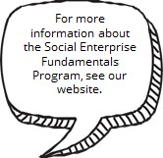

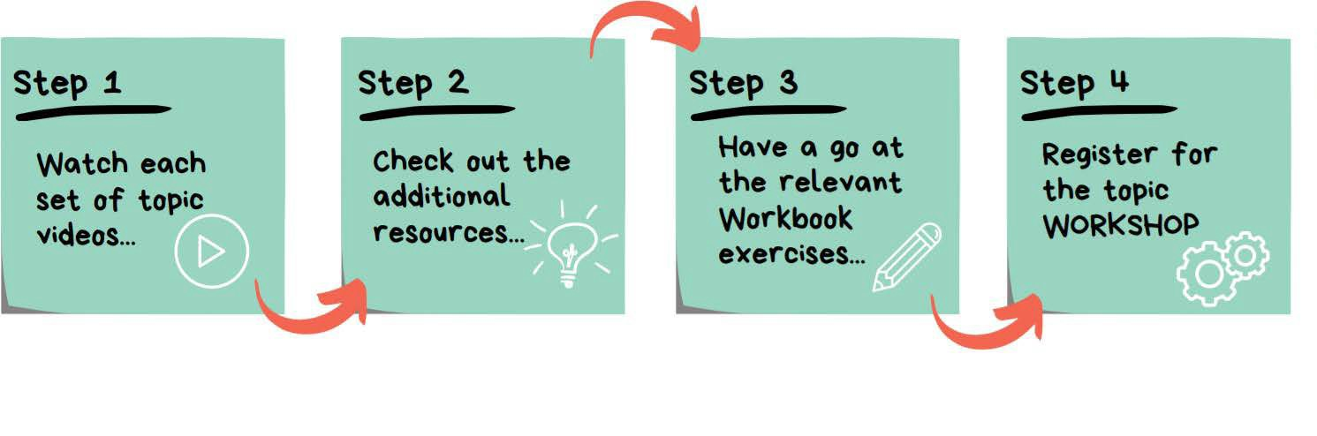
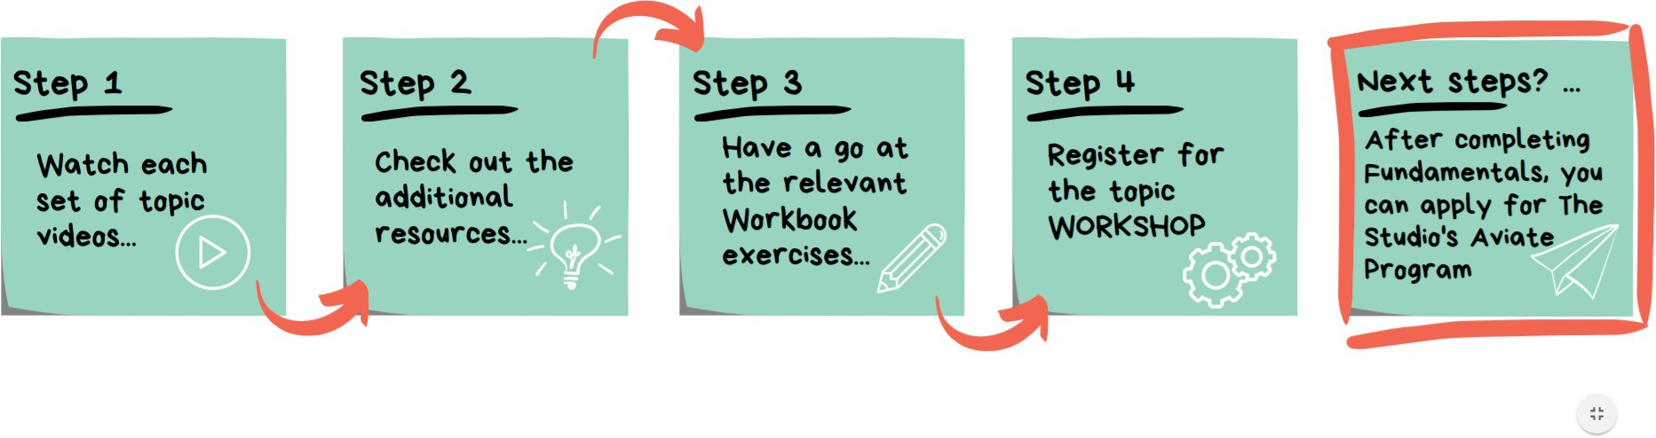
How to use this Workbook
This Workbook accompanies The Studio's Social Enterprise Fundamentals Program.
The Social Enterprise Fundamentals Program consists of four key topics: Introducing social enterprise
Designing for impact
Social enterprise business model elements
Thinking aboutfeasibility
Each topic includes: a series of short videos that cover the basics of each topic; additional links, information and resources; related exercises and tools in this Workbook; and a series of online workshops.
We suggest you watch the videos for a topic and then complete the relevant Workbook pages. You can then register to join an online workshop. The workshops will build on the content of the videos and the Workbook exercises – you will be guided to apply your new knowledge and have the opportunity to ask questions.
For more information about the Social
Enterprise Fundamentals
Program see our website.

Slide 4

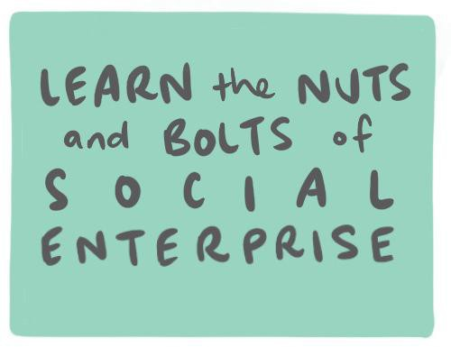

CONTENTS
Be sure to watch the topic videos before trying the exercises!
Topic 1: Introducing social enterprise
Exercise #1: Social enterprise types
Topic 2: Designing for impact
Exercise #2: Causes map Exercise #3: Problem definition Exercise #4: Theory of change
Exercise #5: Ecosystem and stakeholder map Exercise #6: Stakeholder analysis
Topic 3: SE business model elements
Exercise #7: Economic value proposition analysis Exercise #8: Social value proposition analysis Exercise #9: Social enterprise business model canvas
Topic 4: Thinking about feasibility
Exercise #10: Establishment costs estimator Exercise #11: Operating costs estimator Exercise #12: Operating income estimator Exercise #13: Initial financial feasibility assessment Exercise #14: What's next?

Slide 5




SOCIAL ENTERPRISE TYPES
Use this tool to: think
about the different
types of social
enterprise and how that affects decision-making.
Topic 1: Introducing social enterprise Fundamentals exercise #: 1
Write your answers here for each example...
Access
Goal: people get what they need regardless of income, location or community
Funding
Goal: maximize profits whist operatingsustainableandethically
Employment
Goal: employment opportunities with support
Can you think of an example of each type of social enterprise?
Who are the beneficiaries (who benefits from the social purpose?)
What is the product/service they sell?
Who are the customers (who buys the product/service?)

Slide 6







CAUSES MAP
Topic 2: Designing for impact Fundamentals exercise #: 2
Use this tool for: exploring
the root causes and impacts
of the issue you are investigating.
What are some of the deeper or longer-term symptoms & causes? Are there things that are less apparent that stem from this issue?
The obvious effects of this issue are...
Other, less obvious effects
are...
The issue is...
The obvious causes are...
Deeper causes are...
After you have completed the map, reflect on where your solution should lie - are you solving a cause or addressing a symptom?

Slide 7
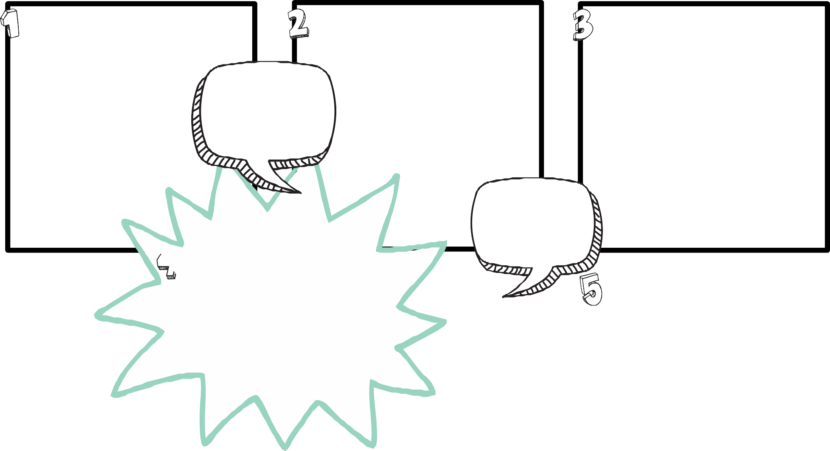
PROBLEM DEFINITION
Use this tool to re-frame the problem as a potential opportunity.
Topic 2: Designing for impact Fundamentals exercise #: 3
Describe in detail the problem you are aiming to address. Why is it important to solve?
Who is affected by this problem - describe the groups of people that itimpacts...
What are the broader, contextual factors that stand in the way of a solution for these people?
The more you know about the problem and the people affected, the better - make sure that your answers are based on consultation and research - rather than assumptions!
After unpacking the problem and thinking about possible 'out of the box' ideas, can you spot an opportunity for a solution?
Brainstorm 'out of the box' ideas (from other contexts or communities) that might be able to be adapted to address this problem (don't hold back - just ideas!)...
Possible opportunities to address the problem...

Slide 8
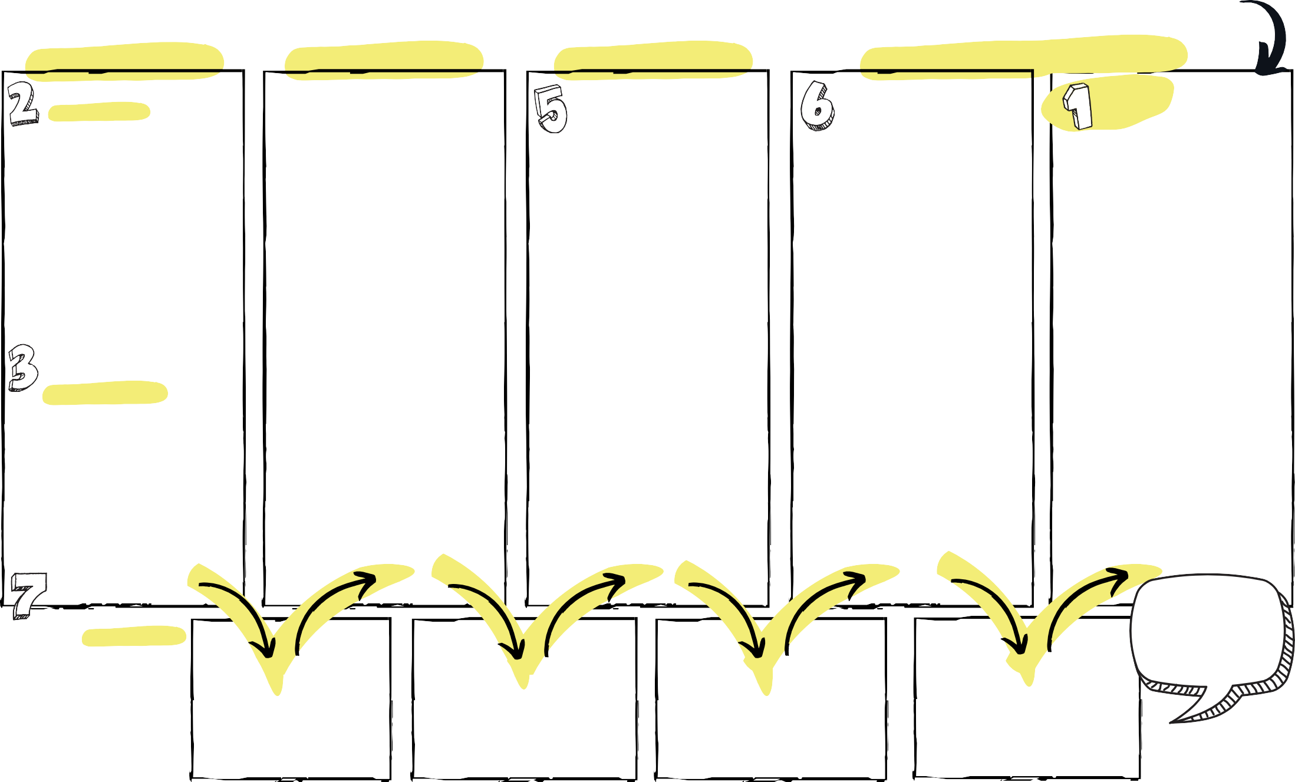

THEORY OF CHANGE
Use this tool to: ensure
there is a logical fit
between the problem
and the proposed solution.
Outcomes
How will the immediate
Topic 2: Designing for impact Fundamentals exercise #: 4
Focus
What is the current issue or problem that you are focusing on as a way to drive systems change?
Solution
What actions and activities are you planning to do to
address the problem?
Outputs
What will the immediate results of your actions be?
results contribute towards the ultimate change you plan to make...
Describe the ultimate, systems-level change or outcome you are planning to contribute towards...
Who is affected by this problem - describe the groups of people that it impacts - are there different groups? ...
Are your planned actions likely to achieve your intended outcomes?
Check the assumptions you are making between each of the two boxes above. Are they logical? Is there reasonable evidence to support their connection?

Slide 9






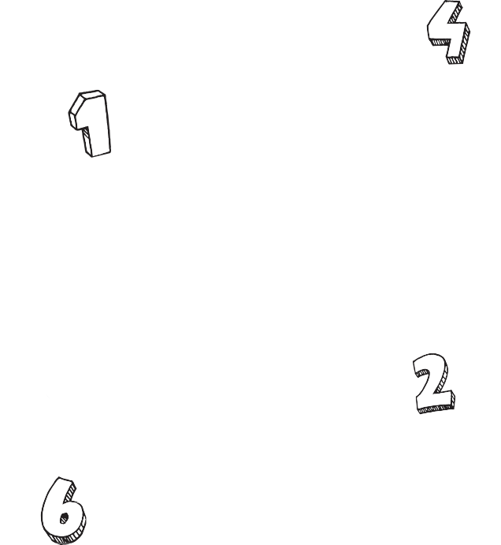






Use this tool to: identify
ECOSYSTEM & STAKEHOLDER MAP
Topic 2: Designing for
your key ecosystem stakeholders.
(based on Bloom & Dees 2008)
Beneficiaries benefit from the social purpose.
Customers buy products/services. They are not always the same!
!
impact Fundamentals exercise #: 5
Government stakeholders...
Customers...
Resource providers - the providers of knowledge, networks, finance & funding, etc...
Social Enterprise
Competitors...
Our social purpose is....
We do this by selling...
Beneficiaries...
Write down your ecosystem stakeholders. These are likely to change over time!
Complementary organisations - partners & suppliers...

Slide 10
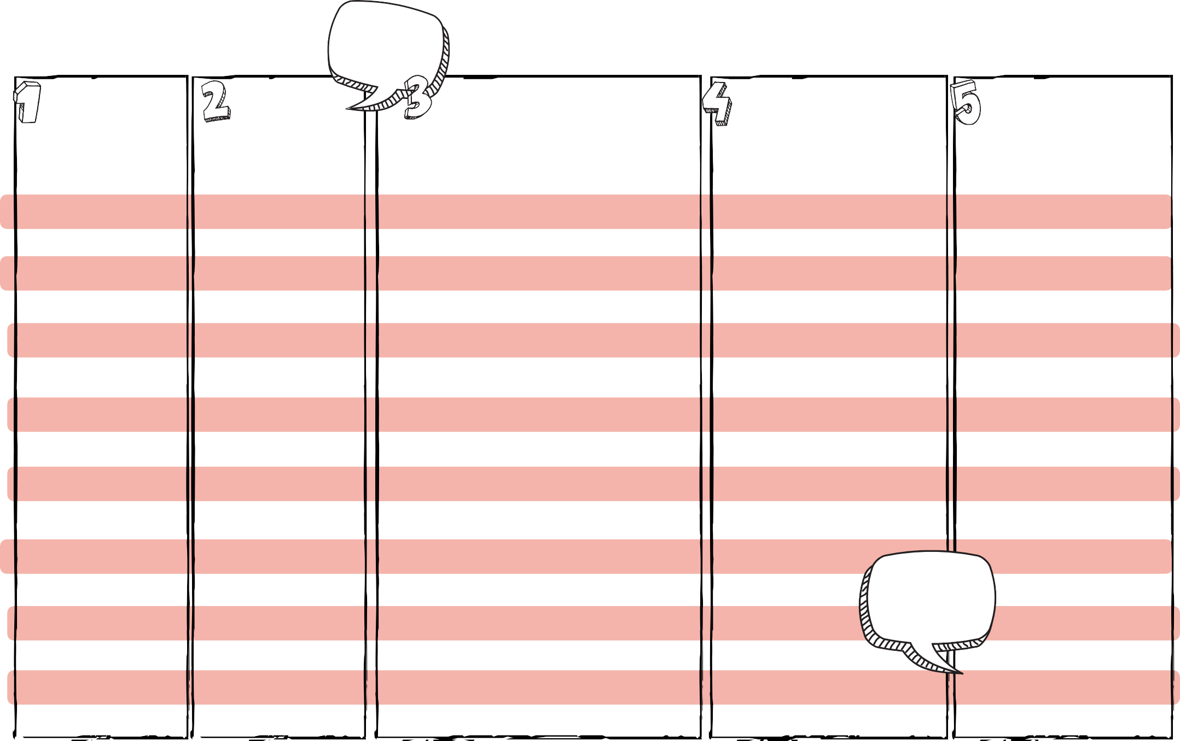
Use this tool to: think
STAKEHOLDER ANALYSIS
Topic 2: Designing for impact
about each stakeholder
and their relationship
to your social enterprise.
Fundamentals exercise #: 6
Refer to the ecosystem & stakeholder map.
Stakeholder name...
Type of stakeholder...
Describe their interest…what are they looking to achieve?
How is their interest aligned with the SE’s success (+ or -), why?
Rate their importance to the SE’s success…
(H, M, L), why?
Stakeholders with high importance should be your priority!

Slide 11
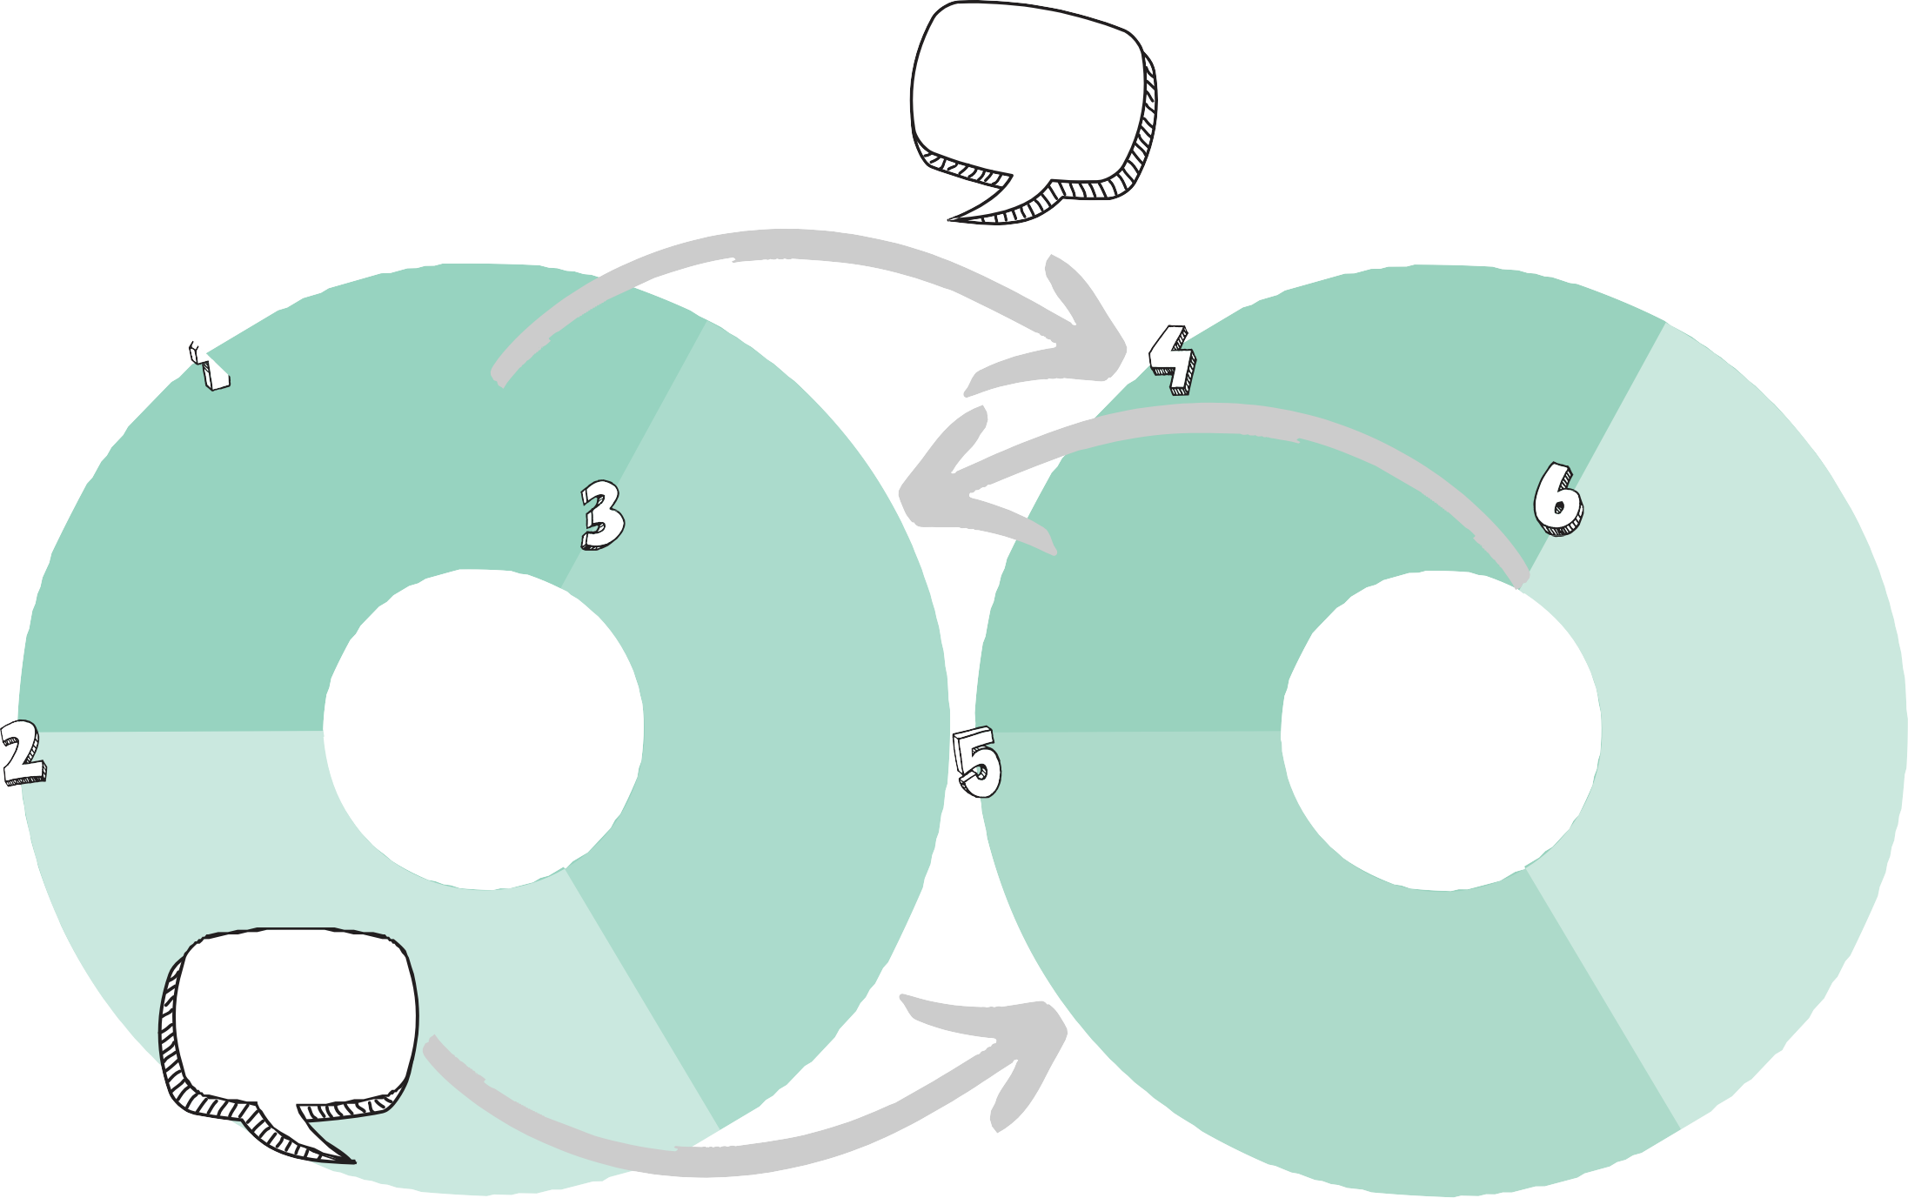
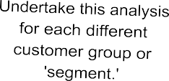
ECONOMIC VALUE PROPOSITION ANALYSIS
Topic 3: Social Enterprise Business Model Elements Fundamentals exercise #: 7
Use this tool to: ensure
the fit between customer
needs and the social
enterprise's product/service.
(based on Osterwalder & Pigneur 2010)
Needs
What problems is your customer looking to solve? What job are they wanting to get done?
Product/Service
Describe the product or service that the social enterprise sells to this customer.
Gains
How does the customer assess if they are pleased with a product or service? What makes them satisfied?
Gain - makers
How does the social enterprise'sproduct/service satisfy and please this customer?
Social Enterprise Customer Segment
Economic Value Creation Activities
Pains
What annoys them about current solutions to their problem?
Pain - relievers
How does the social enterprise'sproduct/service reduce or eliminate what currently annoys this customer?
Check you have alignment between the customers' needs and the social enterprise's products/services.

Slide 12
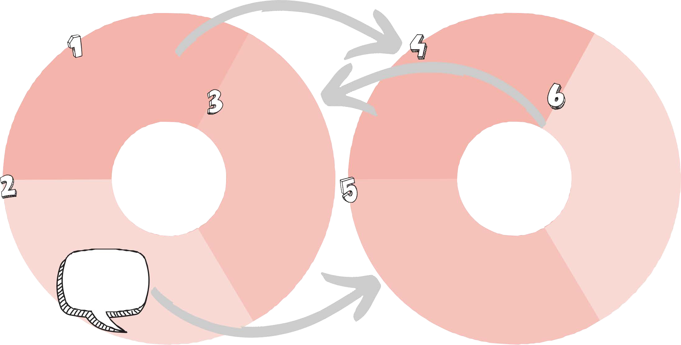
SOCIAL VALUE PROPOSITION ANALYSIS
Topic 3: Social Enterprise Business Model Elements Fundamentals exercise #: 8
Use this tool to: ensure the fit between beneficiaries' needs and the social enterprise's
activities.
(based on Osterwalder & Pigneur 2010)
Problem
What is the problem thatthe beneficiary group is currently facing?
Solution
Describe how the social enterprise addresses the problem that the beneficiary group faces.
Gains
What would the beneficiary group stand to gain if this problem was addressed?
Gain - makers
How does the social enterprise's solution and approach create added or bigger-picture benefits for the beneficiaries?
Social Enterprise Beneficiary Group
Social Value Creation Activities
Pains
What is standing in the way of the beneficiary group? What is exacerbating the problem they face?
Pain - relievers
How does the social
enterprise work towards addressing the things that exacerbate or contribute toward the beneficiary group's problem?
Check you have alignment between the beneficiaries' needs and the social enterprise's activities.

Slide 13
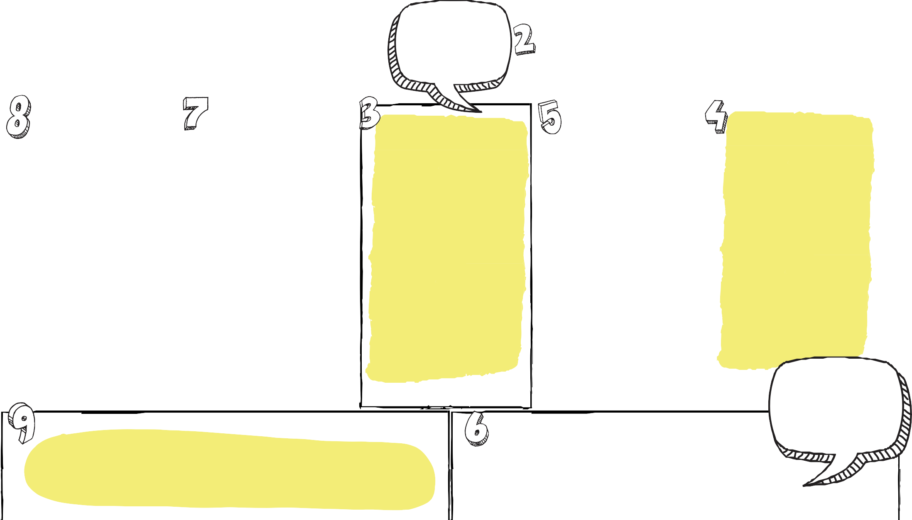

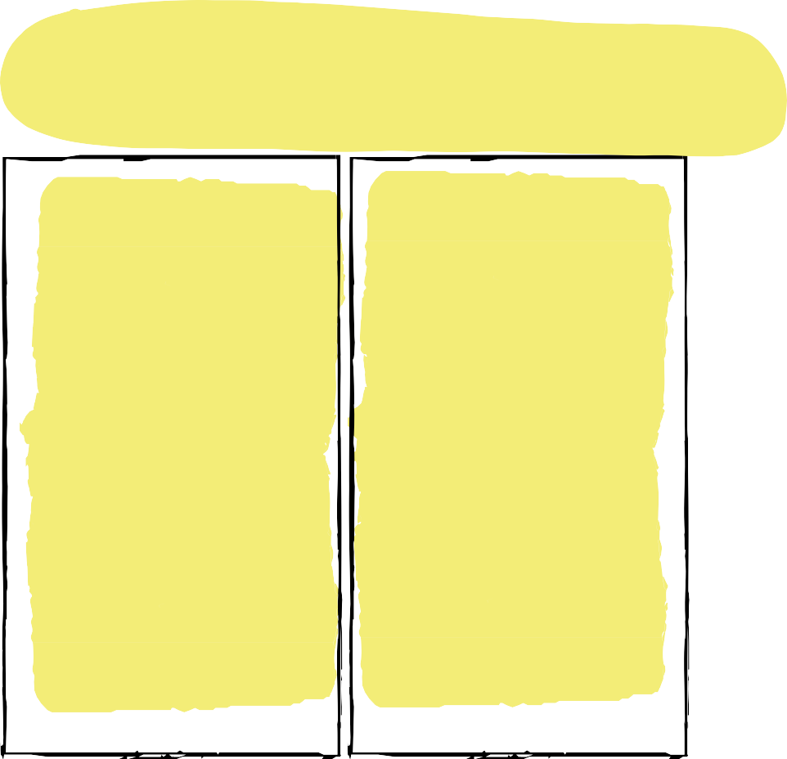

SE BUSINESS MODEL
Use this tool to: explore how the different components of
your SE business model work together to create social value.
(based on Osterwalder & Pigneur 2010)
CANVAS
Topic 3: Social Enterprise Business Model Elements
Fundamentals exercise #: 9
Refer back to your Theory of Change and Ecosystem Map for 'social purpose', 'beneficiaries' & 'customers.'
Social purpose:
What social problem isyour
SE working to address?
Beneficiaries:
Who are the people thatbenefit directly from the SE's social purpose? (beneficiaries).
Partners' skills & assets
What partnerships are needed for the social enterprise to create economic value and deliver its social purpose?
Activities & required people, skills & assets
What are the key activities required for the social enterprise to createeconomic value and deliver its social purpose? Therefore, what skills, resources, infrastructure and assets are needed?
Economic Value Proposition
What product or serviceare you selling to your customers? What problem does it solve for them?
Reaching your beneficiaries & customers
How does the social enterprise connect with and deliver to beneficiaries and customers?
Customer segments
Who are the main groups of people that your social enterprise sells to?
Be careful not to be overly optimistic about the income that can be generated; make sure that the assumptions informing your estimate are reasonable.
Expenses
How much will it cost the social enterprise to deliver the economic value proposition and the social purpose annually? (see exercise #12).
Income
Identify where the social enterprise's income will come from and estimate how much will be earned annually (see exercise #11).

Slide 14





ESTABLISHMENT COSTS ESTIMATOR
Topic 4: Thinking about feasibility Fundamentals exercise #: 10
Use this tool to: identify and estimate the cost of establishing a social enterprise (rather than operating it).
List and describe all the items that you need to have in place to establish the social enterprise.
Item:
Provide a reliable estimate ofthe cost of each of these items.
It is important that you are reasonably conservative with your estimates of costs
- use quotes or other reliable sources of information where you can.
$
Item:
Item: Item: Item:
Item:
$
$
$
$
$
Total Estimated Establishment Costs = $

Slide 15
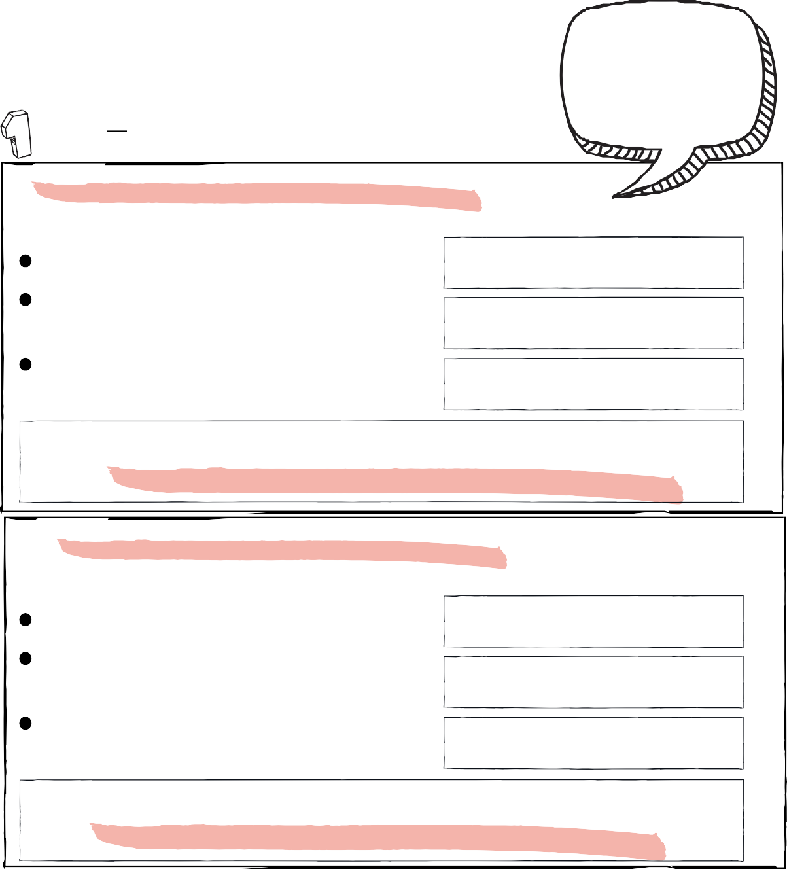
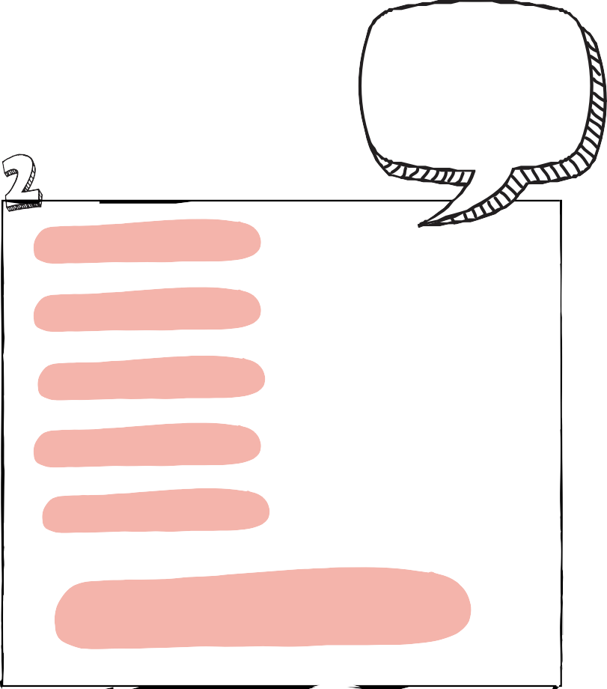
OPERATING INCOME
Use this tool to: estimate the operating income of
your social enterprise, once it is established and you have developed the customer base.
Remember to include income from government funding programs if they
ESTIMATOR
Topic 4: Thinking about feasibility Fundamentals exercise #: 11
Identify all the key products or services that your social enterprise plans to deliver to its customers...
Customer segment:
Product or service they buy:
Refer to your SE Business Model Canvas to make sure you include all products/services and customers - you may need more boxes!
Number of customers per year ......... = Number of times each customer purchases each year .................................... =
Price of each purchase ..............................
customers/year
x
times/year
x
are payments associated
Total all the estimated product
revenue to give you an overall, estimated operating income.
with the enterprise's
operations.
$
+
+
+
+
= $
Estimated product revenue = $ (annually)
=
$
$
Customer segment:
Product or service they buy:
$
Number of customers per year .........
Number of times each customer purchases each year ....................................
Price of each purchase ..............................
=
customers/year
x
times/year
x
=
$
=
Total estimated operating income = $ (annually)
Estimated product revenue = $ (annually)

Slide 16
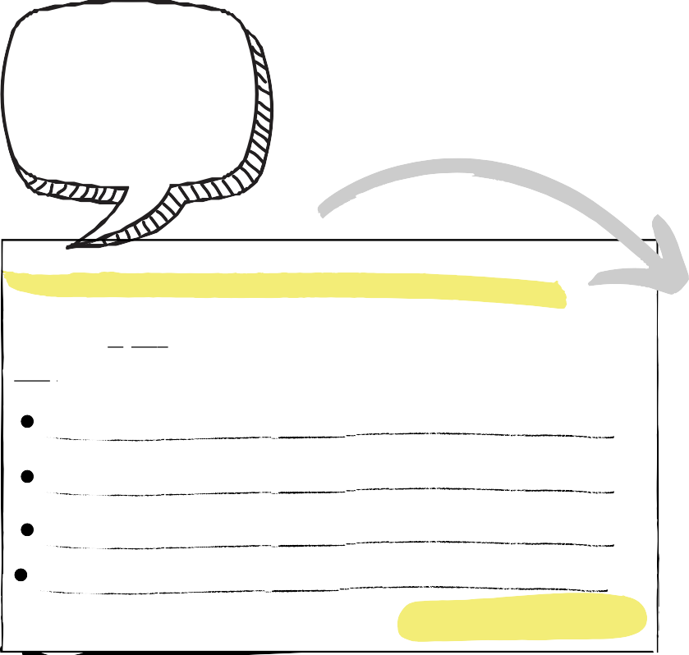

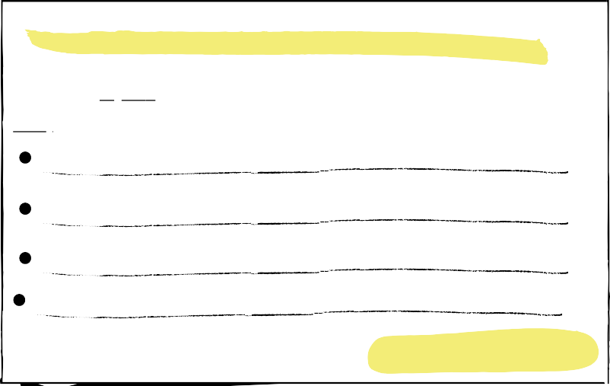


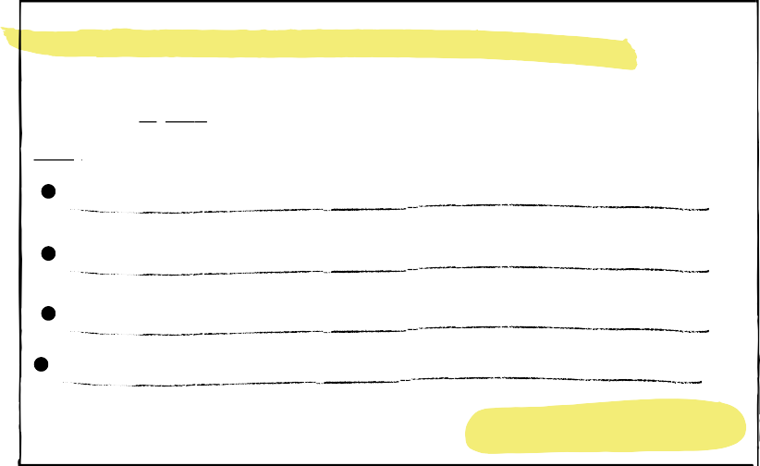
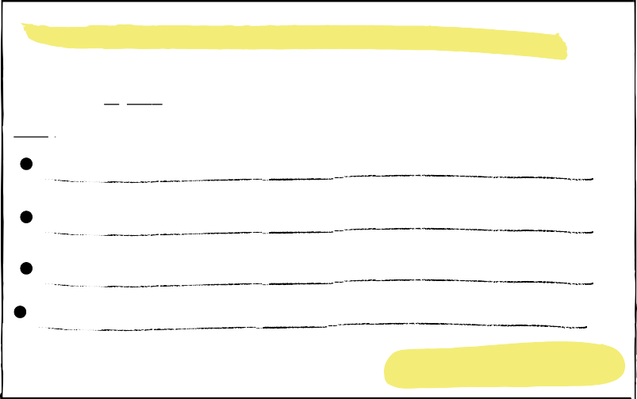
OPERATING EXPENSES ESTIMATOR
Use this tool to: identify and estimate the cost of delivering the social
purpose and your economic value proposition.
Topic 4: Thinking about feasibility
Fundamentals exercise #: 12
Refer to your SE Business Model Canvas to make sure you list all the key activities you will need to do to deliver the economic and social value propositions.
Identify all the key activities that your social enterprise needs to undertake to deliver on the economic and social value propositions...
Activity name:
What does the activity achieve?:
List the inputs required for this activity and estimate the cost of each input:
= $
= $
= $
= $
Estimated activity cost = $
Activity name:
What does the activity achieve?:
List the inputs required for this activity and estimate the cost of each input:
= $
= $
= $
= $
Estimated activity cost = $
Total all the estimated activity costs to give you an overall, estimated operating cost.
$
+
+
+
+
$
$
Activity name:
What does the activity achieve?:
List the inputs required for this activity and estimate the cost of each input:
= $
= $
= $
= $
Estimated activity cost = $
Activity name:
What does the activity achieve?:
List the inputs required for this activity and estimate the cost of each input:
= $
= $
= $
= $
Estimated activity cost = $
$
$
Total estimated operating costs = $ (annually)

Slide 17
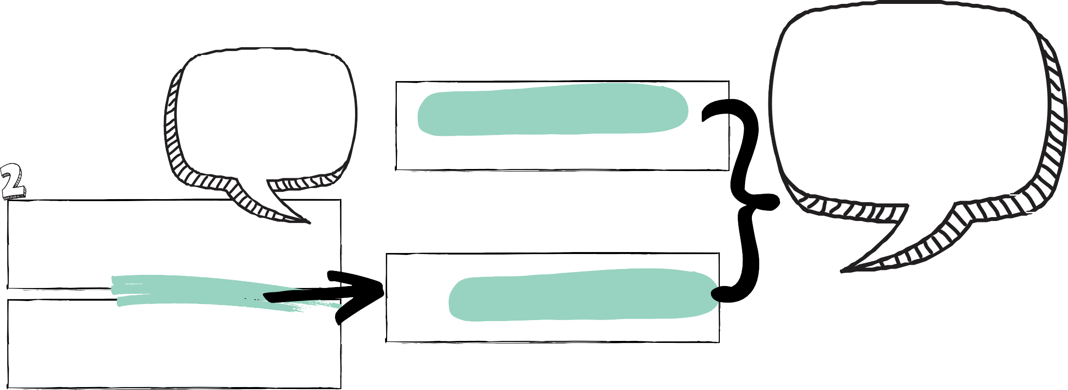

INITIAL FINANCIAL FEASIBILITY ASSESSMENT
Topic 4: Thinking about feasibility Fundamentals exercise #: 13
Use this tool to: help inform your initial feasibility assessment from a financial perspective. Before you commence this exercise, we suggest you review your Theory of Change and confirm what you plan to do has the potential to create impact.
Once you have the estimate of establishment costs, it is important to think about the likelihood that you will be able to raise the funds ... this will inform your decision about the best legal structure for your enterprise
NB: It will take time to build your customer base and
therefore your first few year's
revenue are unlikely to reach this estimate - the gap between
this and your costs will also
need to be covered by your startup capital.
Total Estimated Establishment Costs = $
too!
Then, look to see that there is the potential for the social enterprise to operate in a financially sustainable manner -
if not, you need to revisit the business model to look at other options.
Total Estimated Operating Income = $
(annually)
minus (-)
Total Estimated Operating
Costs = $ (annually)
Total Estimated Operating Surplus/Deficit = $ (annually)

Slide 18


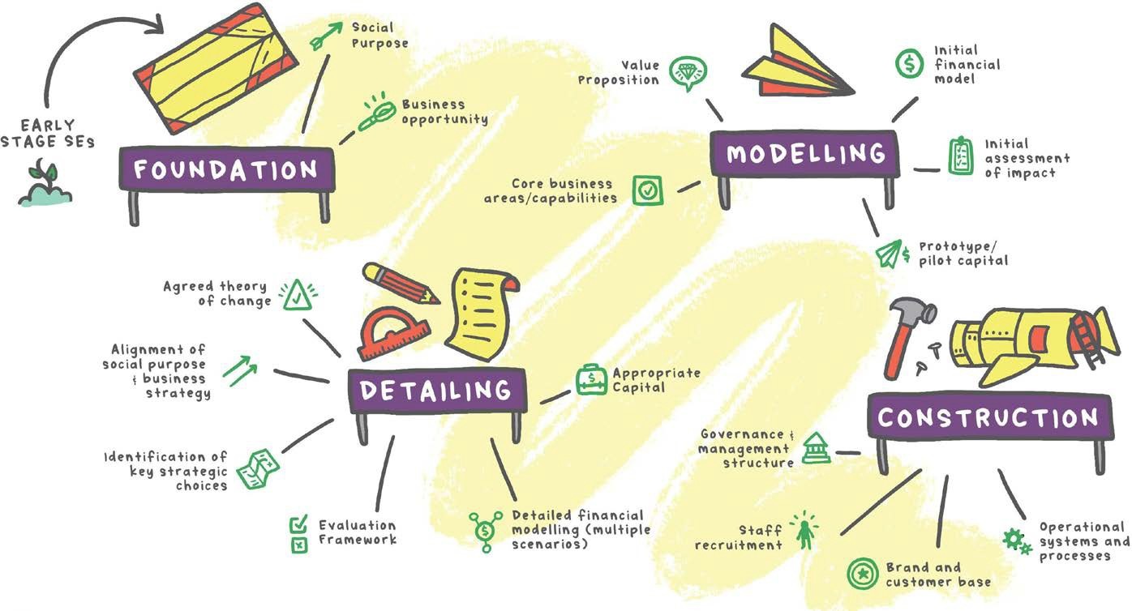
WHAT'S NEXT?
Use this tool to: inform your next steps
Topic 4: Thinking about feasibility Fundamentals exercise #: 14
You are
(somewhere around) here!
If your initial feasibility assessment looks promising, it is time to move onto more detailed development of the MODEL.
After initially evaluating the likely feasibility of your social enterprise,
you now need to circle back to the social enterprise business model and develop your plan so that you can work towards some initial capital.

Slide 19


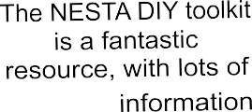
REFERENCES
Bloom & Dees. (2008). Cultivate your ecosystem. Stanford Social Innovation Review, 6(1), 47-53. https://ssir.org/articles/entry/ cultivate_your_ecosystem
Osterwalder & Pigneur. (2010). Business model generation: A handbook for visionaries, game changers, and challengers. Wiley, New Jersey. https://www.strategyzer.com/books/business- model-generation
…and other great info
NESTA DIY Toolkit: Development impact and you: Practical tools to trigger and support social innovation. NESTA & The Rockefeller Foundation, United Kingdom. https://diytoolkit.org/
© Swinburne University of Technology

Slide 20



The Social Enterprise Fundamentals are a set of resources specifically designed for anyone looking to, or in the process of, starting a social enterprise in Australia. The resources consist of videos, accompanying resources and a workbook.
The Social Enterprise Fundamentals are an initiative of the Swinburne Social Startup Studio, part of the Centre for Social Impact, Swinburne University of Technology, Melbourne. They have been developed with generous support from the Victorian Government Department of Jobs, Precincts and Regions.
https://www.socialstartupstudio.com.au

